Slide 1
Invertebrate survey equipment
Entomology Summer School
8th July 2024
Andrew Cherrill

Slide 2
Timetable
Sampling methods for insects – Andy Cherrill
Surveillance and monitoring for insects – Tom Pope
Field work – setting up traps

Slide 3
Sampling methods
Introduction to methods
Equipment
Sampling bias
Efficiency
Outcomes:
An introduction to some key concepts, methods and issues in field sampling of invertebrates

Slide 4
Some basic concepts
Passive sampling
taking advantage of animals’ behaviours without manipulation
Active sampling
using the species’ behaviour to encourage it to enter a trap
proactively collecting the species (i.e. the surveyor is active)

Slide 5
Passive sampling methods
Invertebrates come to the trap (without manipulation of their behaviour):
Pitfall traps
Leaf litter traps
Flight interception traps
(Acoustic monitoring)
Numbers reflect activity level of species
Influenced by surrounding vegetation and weather

Slide 6
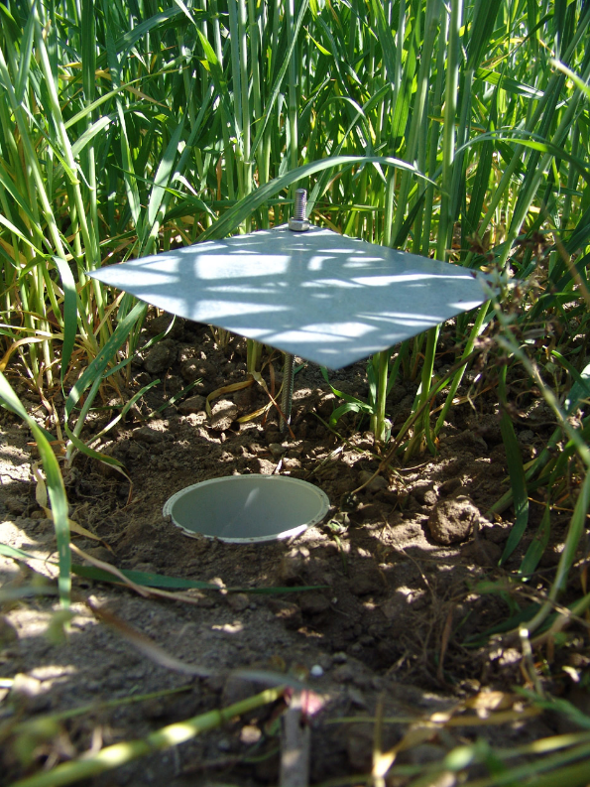
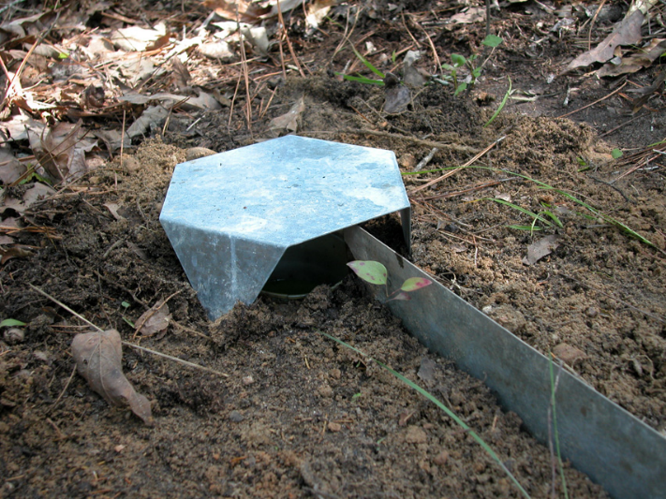
Pitfall traps

Slide 7
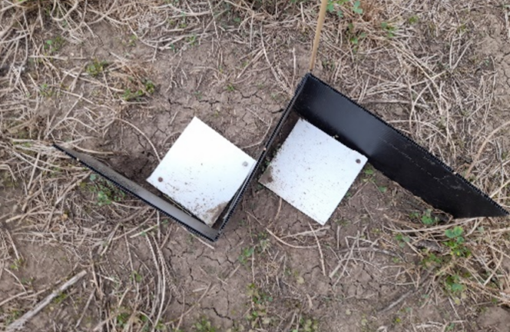
Pitfall traps

Slide 8
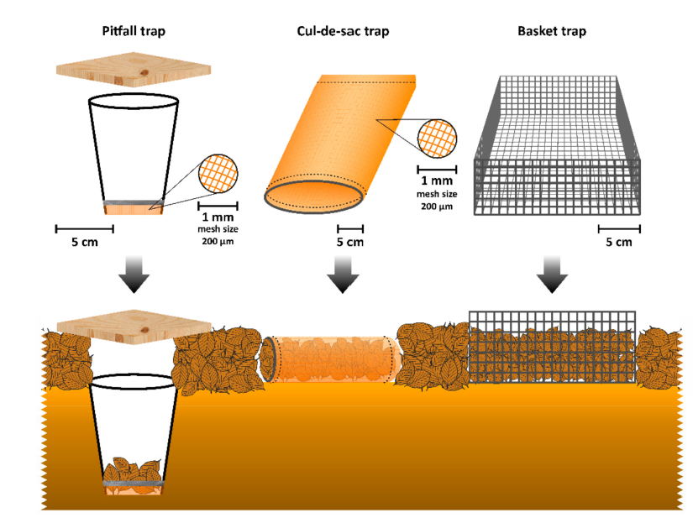
Traps for leaf litter invertebrates
Ruiz-Lupion et al. 2019 Insects

Slide 9
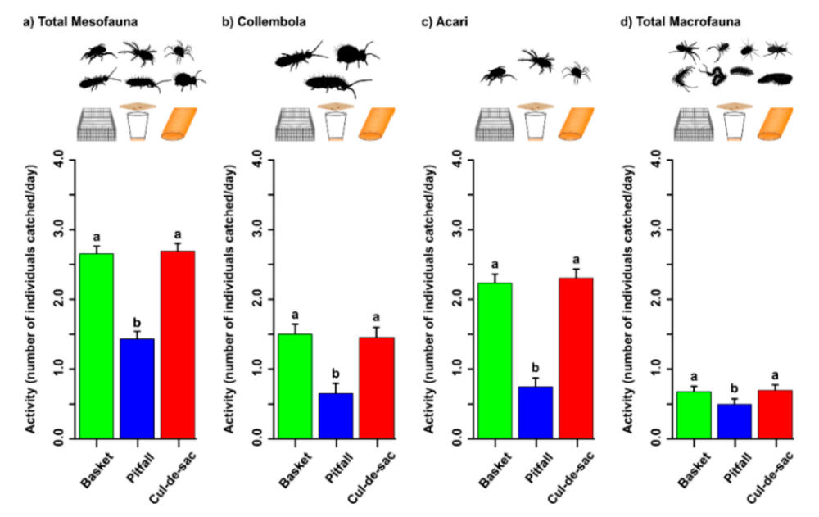

Slide 10
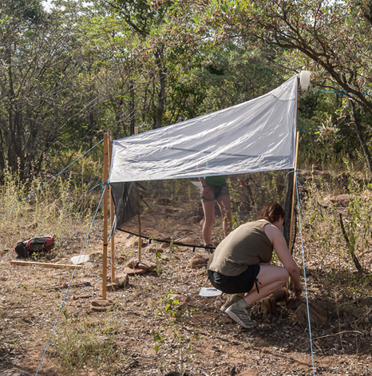
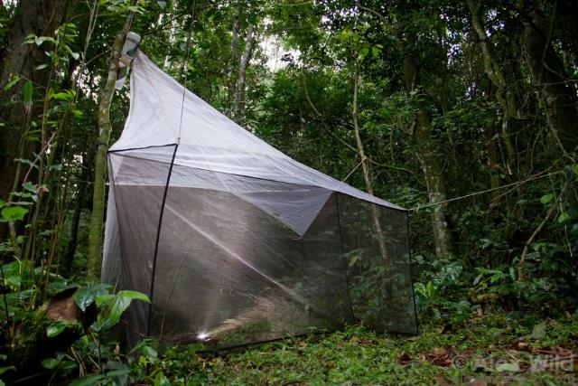
Flight interception traps
Malaise traps

Slide 11
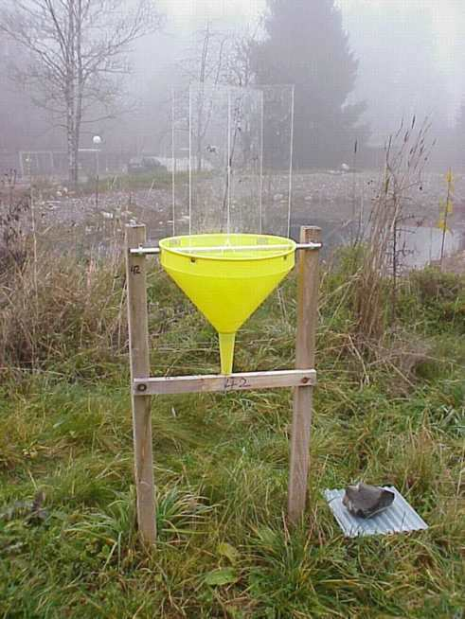
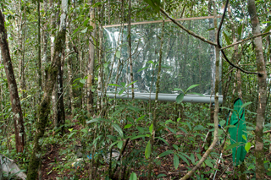
Flight interception traps
Window traps

Slide 12
Acoustic detection
Many insects produce sounds:
Mating calls – e.g. Orthoptera
Wing beats – e.g. bee species
Feeding and burrowing – e.g. wood, grain pests

Slide 13
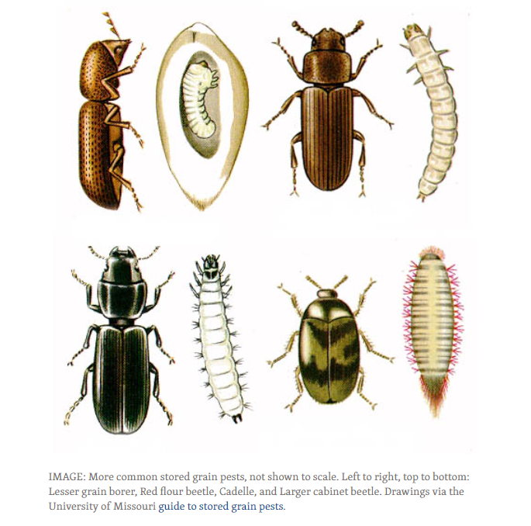
Acoustic detection
Detection of hidden life stages in grain, wood, and growing plant material

Slide 14
Acoustic detection
Passive non-destructive sampling
Remote automated detection
Continuous monitoring

Slide 15
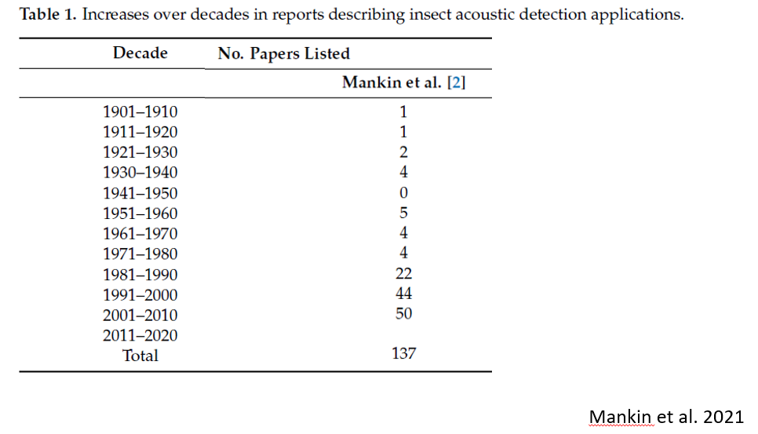

Acoustic detection

Slide 16
Active sampling methods
Using attractants to increase numbers entering a trap:
Food bait traps
Pheromone traps
Coloured water traps
Light traps

Slide 17
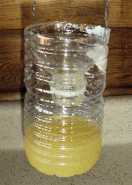
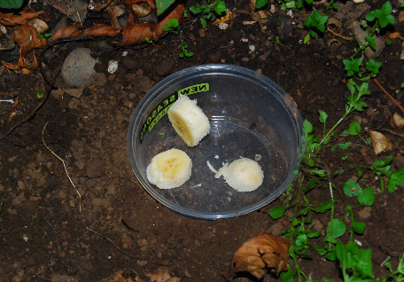
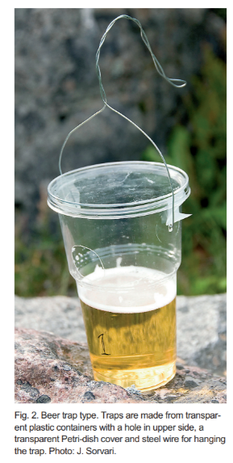
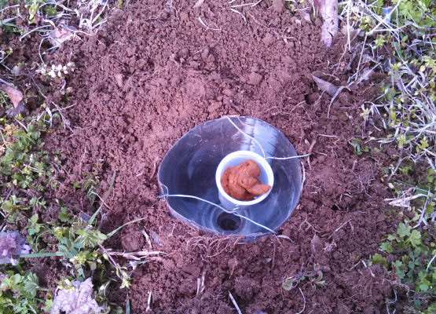
Food baited traps

Slide 18
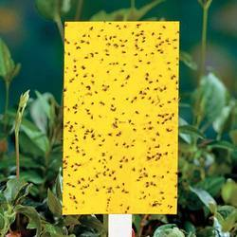
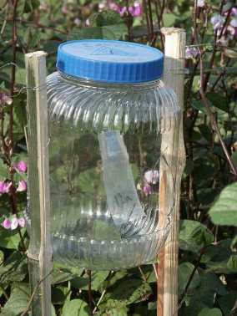
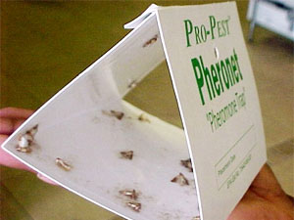
Pheromone lures and traps
Attractant combined with killing agent

Slide 19
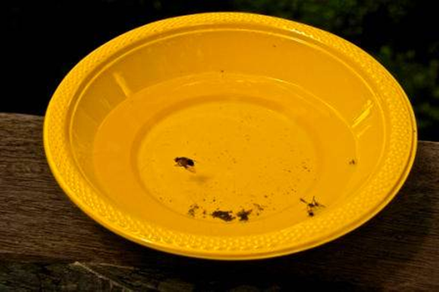
Water pan traps

Slide 20
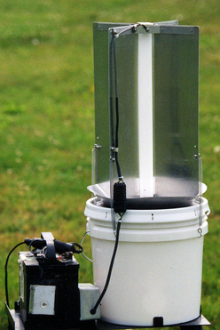
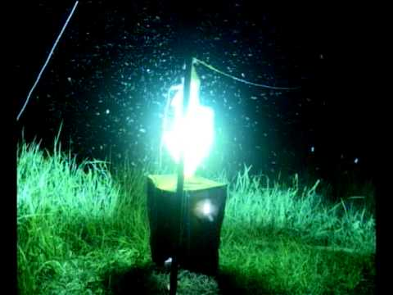
Light traps

Slide 21
Active sampling methods
Where the surveyor is active in collecting:
Soil sampling and extraction
Sweep netting
Vacuum sampling
Beating trees / bushes
Kick sampling / pond-netting
Hand searching

Slide 22
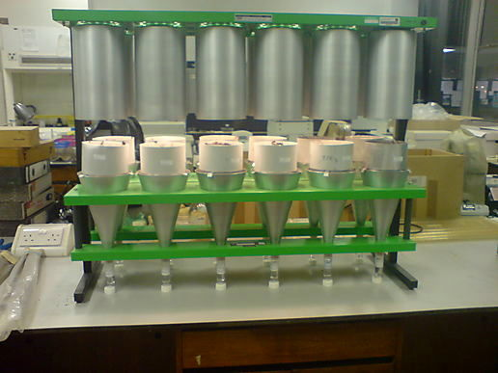
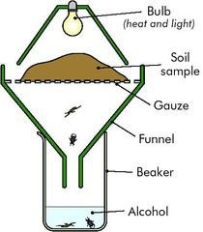
Soil invertebrates
Tulgren funnel

Slide 23
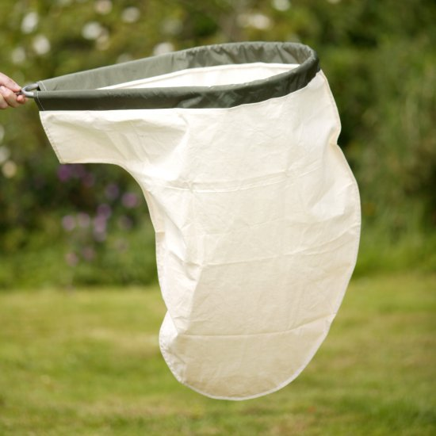
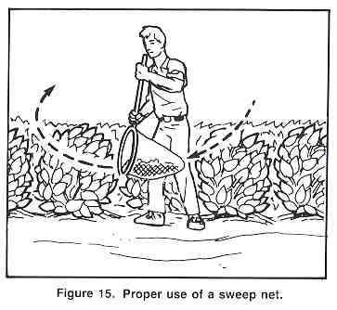
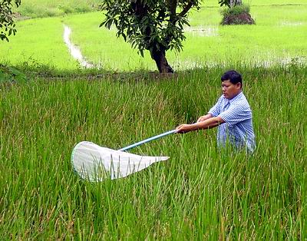
Sweep netting
a

Slide 24
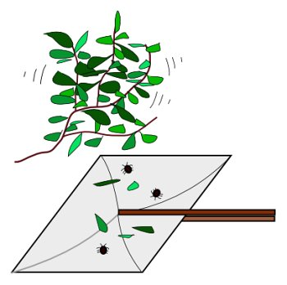
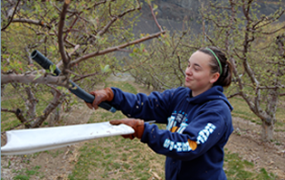
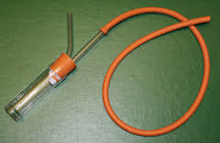
Beating trees / bushes

Slide 25
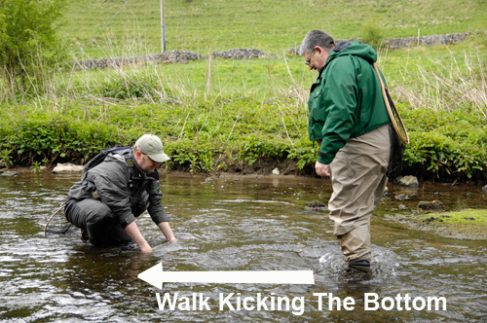
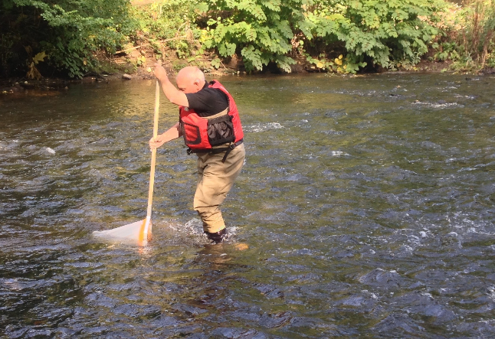
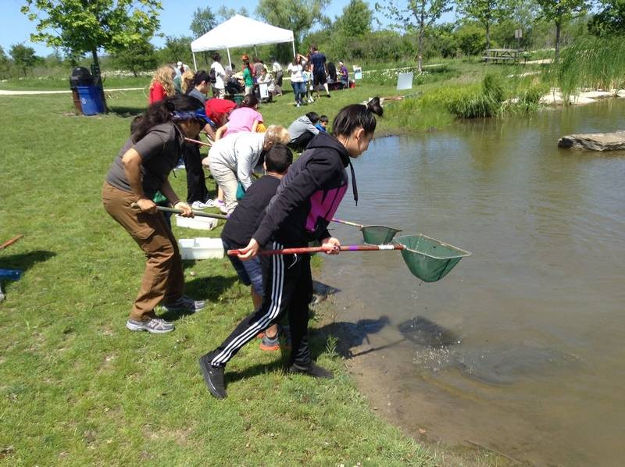
Kick sampling / pond-netting

Slide 26
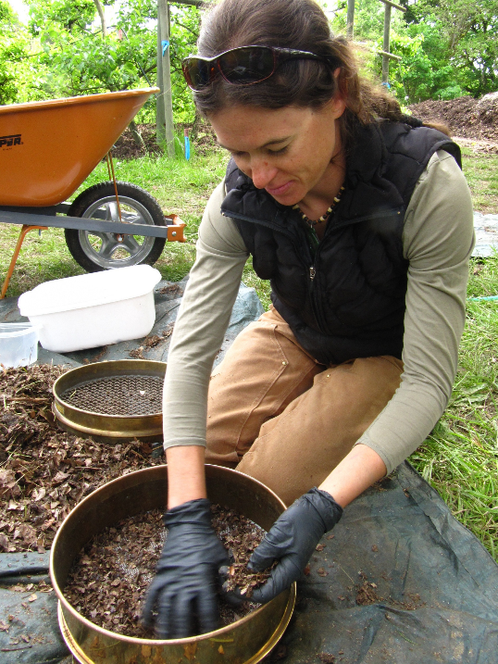
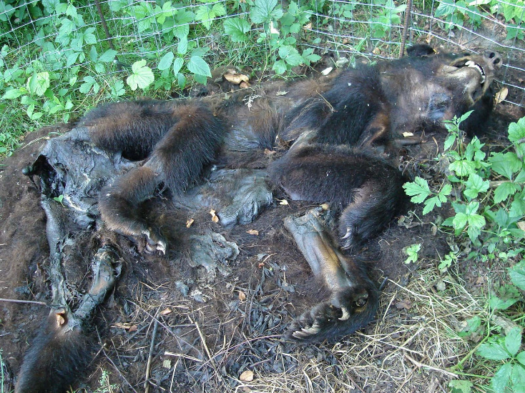
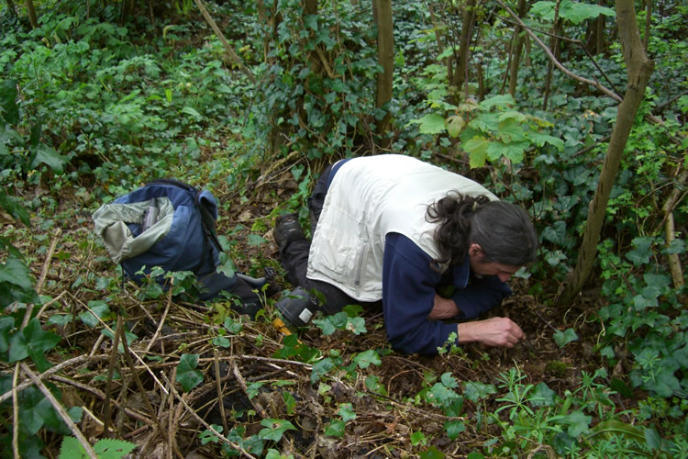
Hand searching

Slide 27
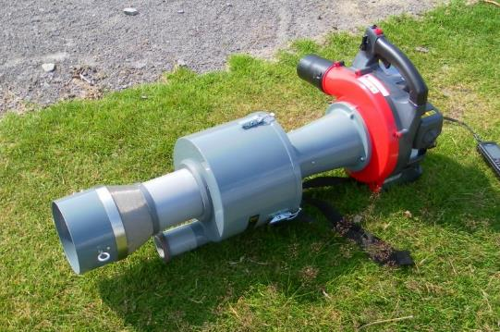
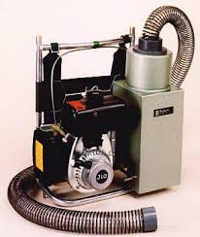
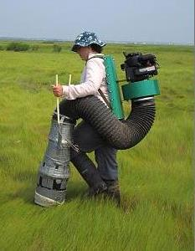
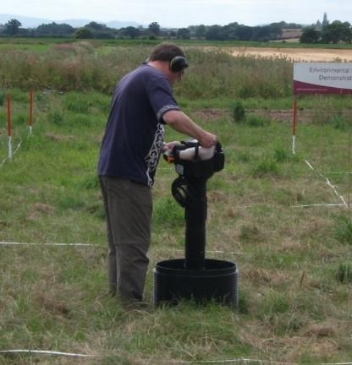
Vacuum sampling
Vortis
Uni-Vac
D-Vac
G-Vac

Slide 28
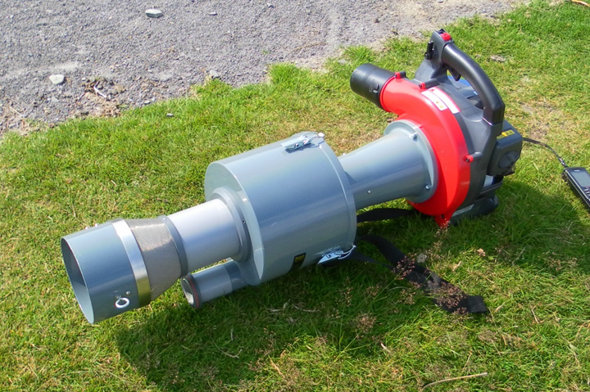

Slide 29
Comparisons between methods
Sampling bias – are some methods better at capturing particular species?
Sampling efficiency – how many species are found for a given amount of sampling effort?
Obtaining reliable estimates of species richness

Slide 30
Sampling bias:
Order | % in sweepnet | % in pitfall traps
Araneae (spiders) | 1.7 | 37.0
Collembola (springtails) | 0.2 | 5.7
Hemiptera (leafhoppers) | 68.3 | 3.1
Diptera (flies) | 9.8 | 5.7
Hymenoptera (wasps, bees) | 12.5 | 4.1
Coleoptera (beetles) | 0.8 | 37.0
Total Number of Invertebrates | 906 | 956

Slide 31
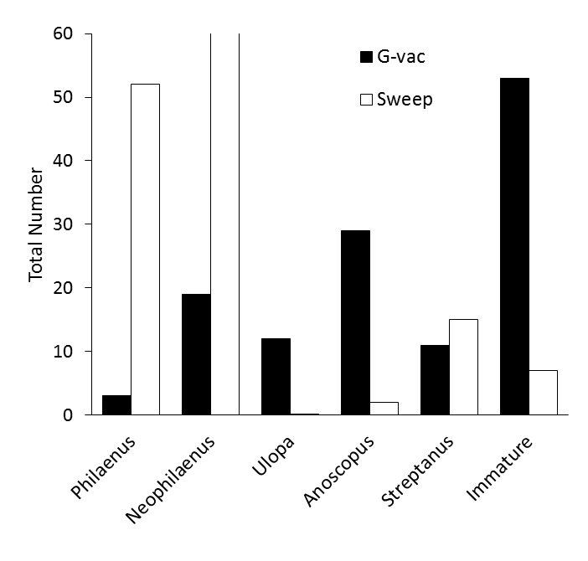
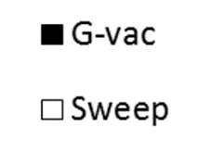
Sweep net vs suction sampler
155
Leafhoppers captured by:
25 sweep samples (each 20 sweeps)
Vs
15 suction samples (each 30s, 0.18m²)

Slide 32
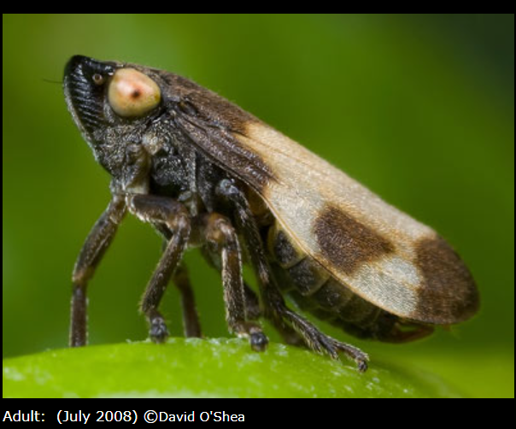
Meadow spittle bug
Philaenus spumarius
Vector for Xylella fastidiosa
Over 1300 host plants worldwide
Occurs relatively high in grassland vegetation profile, but at relatively low density
Sweep netting along transects most effective for the adults

Slide 33
Sampling and species inventory
Inventory – detecting all species at a site
Keep sampling until no ‘new’ species are found
Plot the accumulative number of species against a measure of ‘sampling effort’
Usually, the number of samples
But number of individuals is useful if comparing different sampling methods

Slide 34
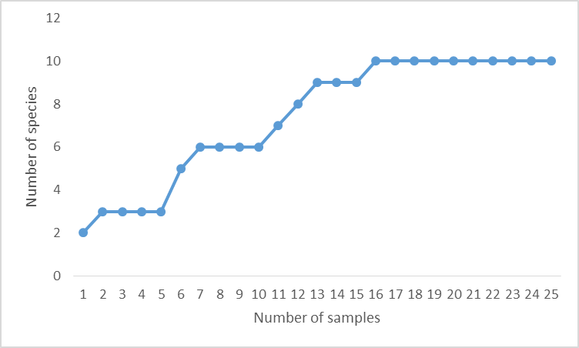
Site A
Sampling is adequate and provides a good estimate of species richness
We can be confident there are approx. 10 species

Slide 35
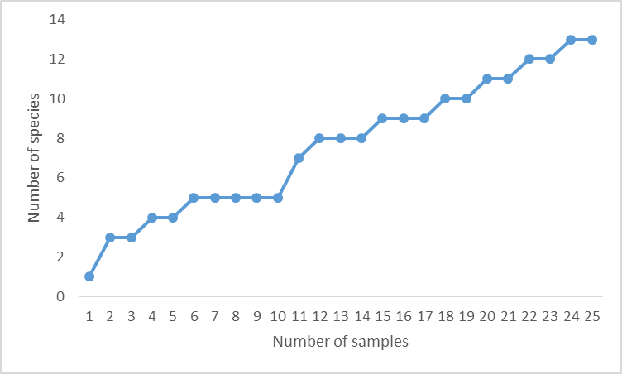
Site B
Sampling is inadequate
Species richness is at least 13, but probably higher

Slide 36
Rarefaction analysis: A useful method for comparing data obtained using different sampling methods. E.g. Equal sampling in terms of number of samples, area sampled and suction time using Vortis and G-vac samplers at two sites:
G-vac
Site 1
Vortis
G-vac
Site 2
Vortis
Combined spider, leafhopper and planthopper data

Slide 37
Sampling methods
Introduction to methods
Equipment
Sampling bias
Efficiency
Outcomes:
An introduction to some key concepts, methods and issues in field sampling of invertebrates

